Slide 1
High Dimensional Data Visualization
Jordan Atwell

Slide 2
Overview
Introduction
Dimension Reordering Algorithms
Clutter Reduction
Similarity Based Attribute Arrangement (SBAA)
Dimension Reduction Algorithms
Similarity Based Attribute Reduction (SBAR)
t-Distributed Stochastic Neighbor Embedding (t-SNE)
Visualization Algorithms
Automated Analysis
Multi-Dimensional Visualization
Journey Through Dimensions
Conclusion

Slide 3
Data visualization
The process of creating an image to visually represent data
Goal is to create an image that represents data well and facilitates a reader’s understanding
Key aspects:
Data
Function
Design

Slide 4
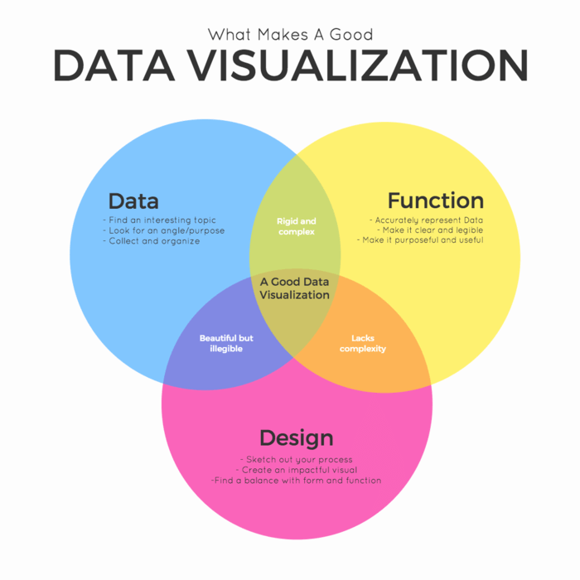

Slide 5
What is high dimensional data?
Several definitions
For p=features and n=records, any dataset where p > n
Data with a few dozen to a few hundred features or few hundred to a few thousand
Data with features so numerous that calculations become difficult
Examples
Chemical compound analysis
DNA microarray analysis
The Curse of Dimensionality

Slide 6
How is high dimensional data visualization different from data visualization?
More complex because of larger numbers of features
Requires preprocessing to be able to create good visualizations
Main methods of preprocessing:
Dimension reordering
Dimension reduction

Slide 7
Dimension Reordering Algorithms

Slide 8

Clutter Reduction
Clutter: crowded and disordered visual entities that obscure the structure in visual displays that can affect a reader’s understanding of information
General Procedure:
Create an initial visualization of the data
Parallel Coordinates
Scatterplot Matrices
Rearrange the order of the attributes to reduce clutter
Create a revised visualization after dimension reorder
Repeat as needed

Slide 9

Parallel Coordinates
Clutter: Proportion of outliers to total number of data points
Technique introduced by Alfred Inselberg in the 1980s
Points represented as connected line segments
Goal is to remove number of outliers through reorganization
Notes:
Heyy

Slide 10
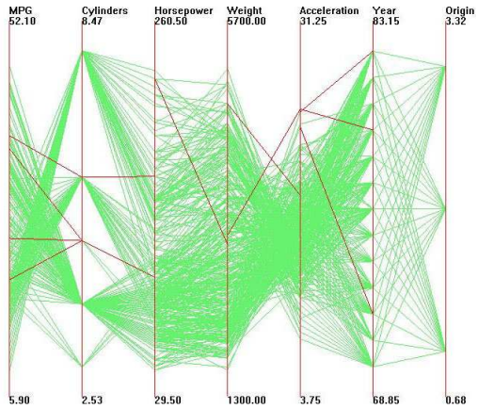
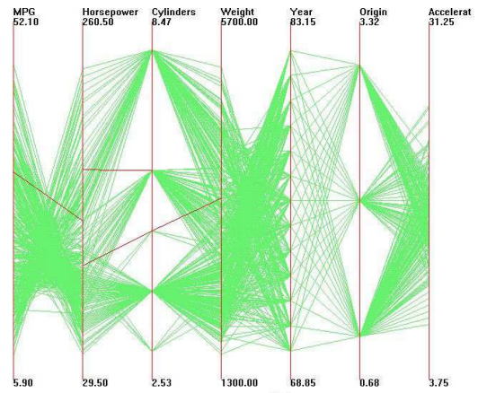
Before and after of reordering the Cars dataset [1]

Slide 11
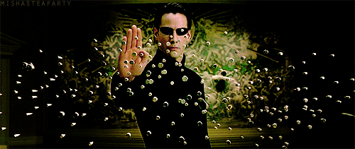
Scatterplot Matrices
Clutter: Lack of structure in matrix
Low vs. high cardinality
Pearson Correlation Coefficient
Goal is to find structure in plots based on the density of clusters
Notes:
Heyy

Slide 12
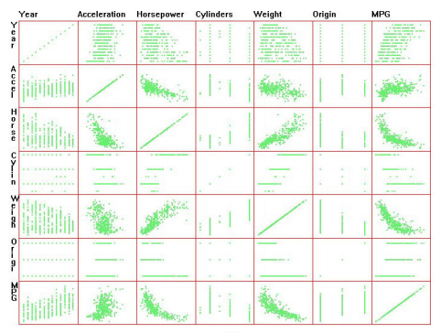
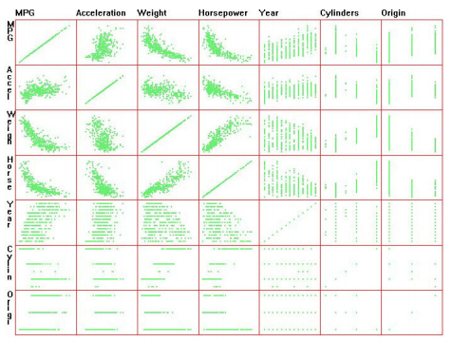
Before and after ordering dimensions by cardinality of the Cars dataset [1]

Slide 13
Similarity Based Attribute Arrangement (SBAA)
Solves attribute arrangement problem with a variation of Nearest Neighbor
Compute similarity matrix S
Find the largest element S_{i,j} of S
Attributes i and j define the axes on the left and right of an arrangement A
Add S_{i,j} to A
Repeat steps 2-4 until all elements of S are in A

Slide 14
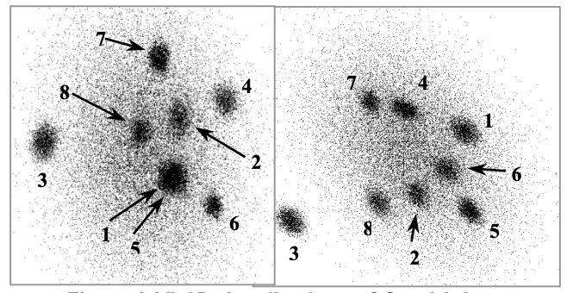
Visualizations of the Quadruped dataset using SBAA [2]

Slide 15
Dimension Reduction Algorithms

Slide 16
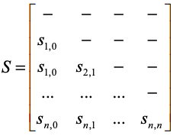
Similarity Based Attribute Reduction (SBAR)
Builds off of SBAA
Eliminates attributes that are most similar to their neighbors in the defined arrangement
Used when too many attributes make visual interpretation more difficult than what they contribute to analysis
Compute similarity matrix S
Get arrangement A from S
Find the greatest value S_{i,j}
Remove attribute i or j from A
Repeat steps 2-4 as needed

Slide 17
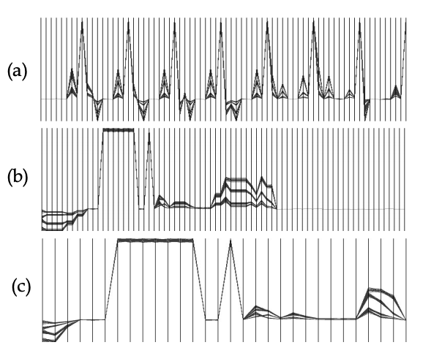
Visualization of the Quadraped dataset using (a) default arrangement, (b) SBAA, and (c) SBAR [2]

Slide 18
t-Distributed Stochastic Neighbor Embedding (t-SNE)
Mapping technique to search for non linear patterns
Local vs. Global approach
Converts Euclidean distances into possible representations of similarities
Maps high dimensional points onto a lower dimension
Minimizes the sum of difference of possibilities
Measures the number of neighbors

Slide 19
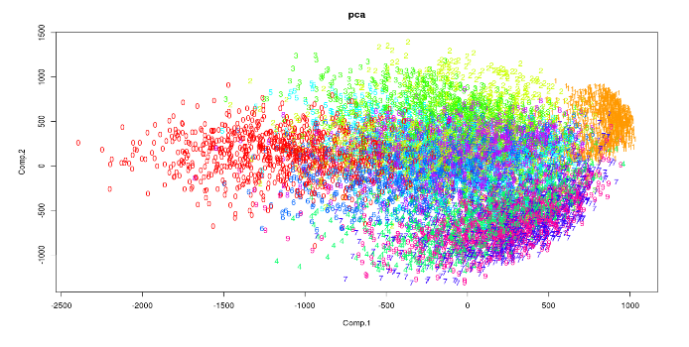
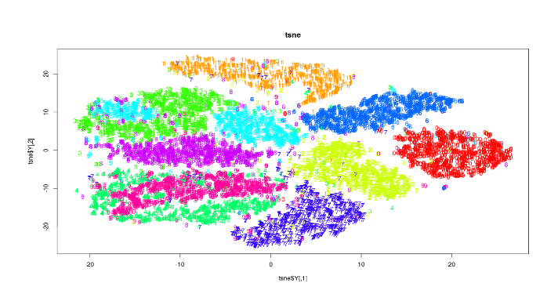
PCA vs t-SNE [3]

Slide 20
Visualization

Slide 21
Automated Analysis
Automatically finds effective visualizations
Classified vs. Unclassified Data
Separation properties: defining properties of each class

Slide 22
Class Density Measure (CDM)
Used for scatterplots with classified data
Goal is to identify plots with minimal overlap between classes
Computes a score reflecting separation properties

Slide 23
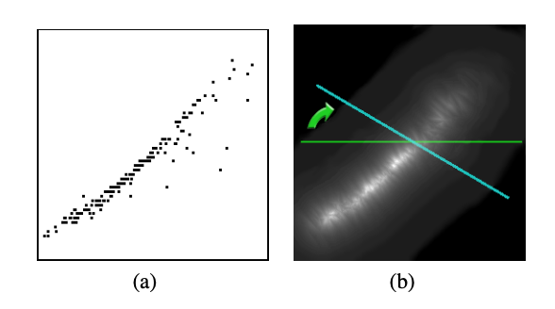
Scatterplot and its density image [4]

Slide 24
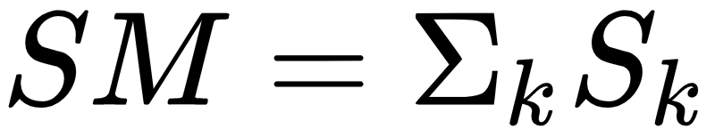
Parallel Coordinates for Classified Data
The lines that belong inside a determined class must be similar in inclination and position
Visualizations that contain less overlapping are good
Similarity Measure (SM)
Encourages visualizations with strong inner class similarities
Penalizes class overlap
Overlap Measure (OM)
Analyzes difference between classes

Slide 25
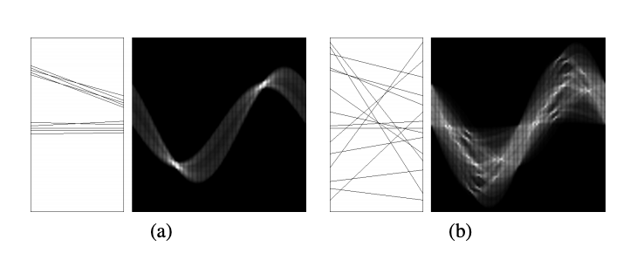
Well-defined vs. no identifiable cluster lines [4]

Slide 26
Multi-Dimensional Visualization
Choosing an appropriate visual type
How to represent multiple dimensions
Color
Facets
Depth
Bad vs. good multi-dimensional visualization

Slide 27
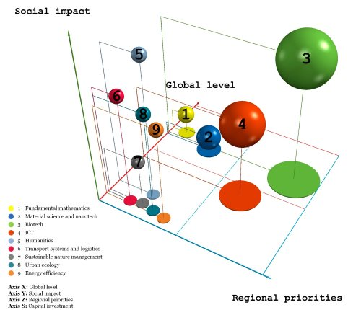

Slide 28
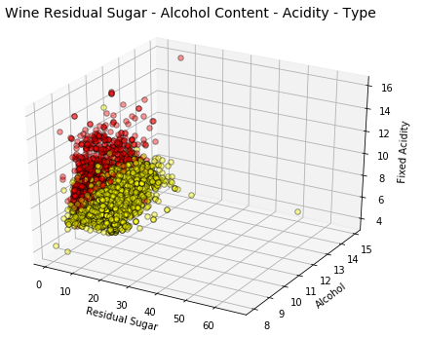
4-D data visualization [5]

Slide 29
Journey Through Dimensions

Slide 30
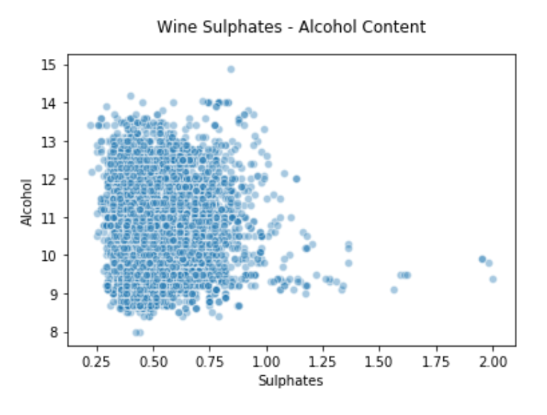
2-D data visualization [5]

Slide 31
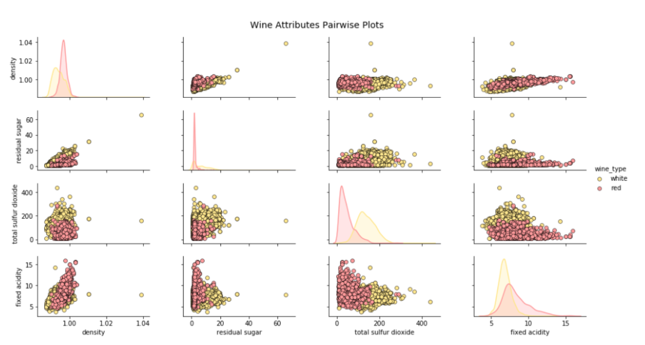
3-D data visualization [5]

Slide 32
4-D data visualization [5]

Slide 33
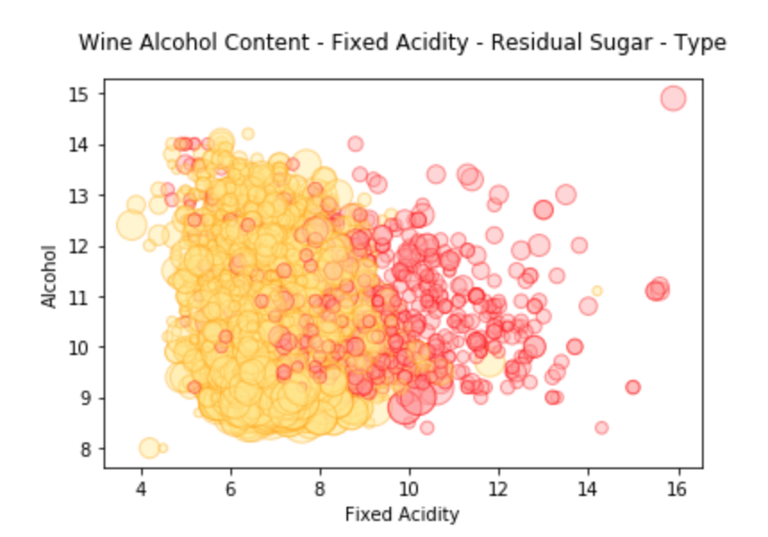
4-D data visualization [5]

Slide 34
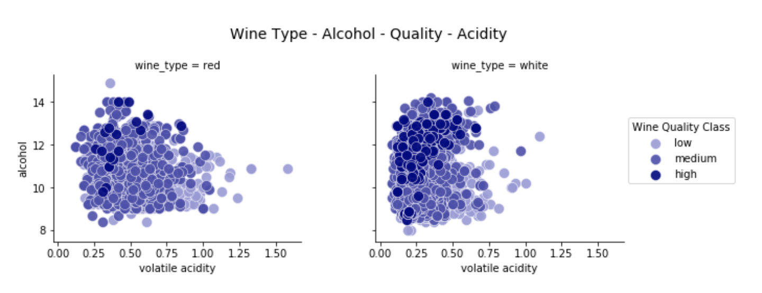
4-D data visualization [5]

Slide 35
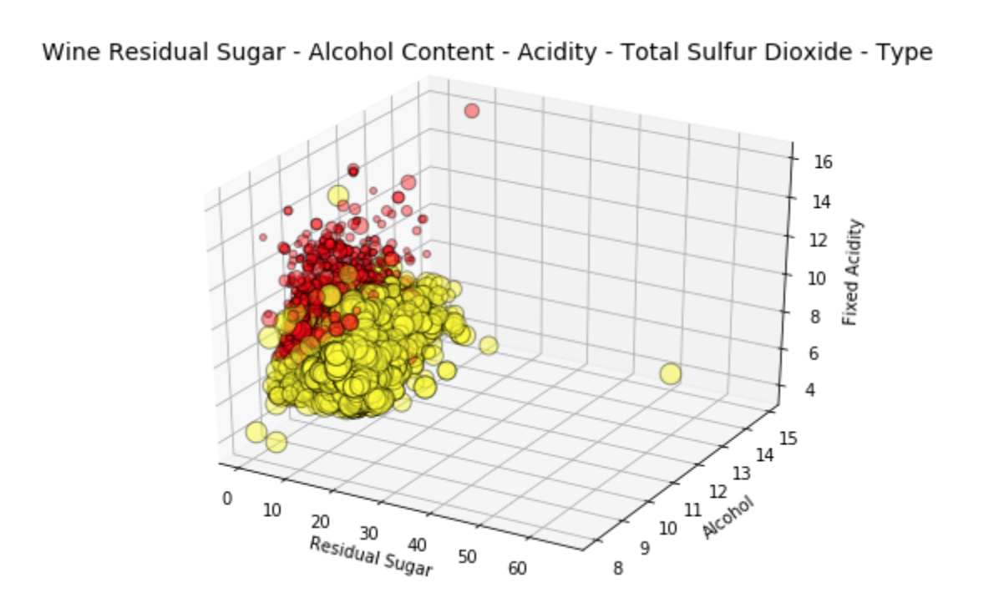
5-D data visualization [5]

Slide 36
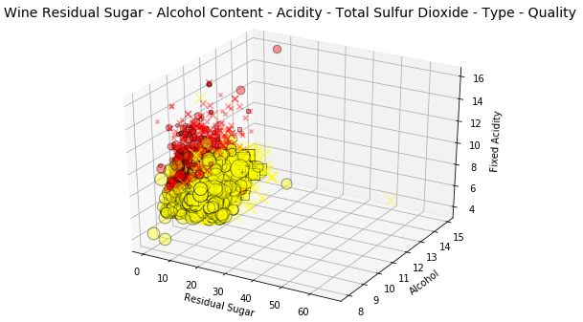
6-D visualization [5]

Slide 37
Conclusion

Slide 38
Conclusion
Good visualizations of high dimensional data are possible
Preprocessing methods
Appropriate visual type
Organization of data
Good visualization methods

Slide 39
Questions?

Slide 40
Sources
[1]W. Peng, M. Ward and E. Rundensteiner, "Clutter Reduction in Multi-Dimensional Data Visualization Using Dimension Reordering", Digitalcommons.wpi.edu, 2004. [Online]. Available: https://digitalcommons.wpi.edu/cgi/viewcontent.cgi?article=1071&context=computerscience-pubs. [Accessed: 23- Feb- 2019].
[2]A. Artero, M. de Oliveira and H. Levkowitz, "Enhanced High Dimensional Data Visualization through Dimension Reduction and Attribute Arrangement", Tenth International Conference on Information Visualisation (IV'06). Available: https://ieeexplore.ieee.org/abstract/document/1648337. [Accessed 13 February 2019].
[3]https://www.analyticsvidhya.com/blog/2017/01/t-sne-implementation-r-python/
[4]https://ieeexplore.ieee.org/abstract/document/5332628
[5]https://towardsdatascience.com/the-art-of-effective-visualization-of-multi-dimensional-data-6c7202990c57

